Slide 1
Application
Application
CLAMR (Cell-Based Adaptive Mesh Refinement)
Repository
https://github.com/brtnfld/CLAMR-1
Has been merged into LANL CLAMR repository
Setting cmake option, -DHDF5_DIR=, enables HDF5 (i.e. defines HAVE_HDF5)
Single source base for both FF HDF5 and non-FF HDF5.
Definition HDF5_FF determines if enabling FF HDF5 or non-FF HDF5.
Bulk of HDF5 code additions made to crux/crux.cpp

Slide 2
Application
CLAMR’s HDF5 APIs
H5Fcreate §
H5Fclose §
H5Gcreate §
H5Gclose §
H5Screate_simple
H5Sselect_hypersla
H5Sclose
H5Acreate §
H5Awrite §
H5Aclose §
H5Dcreate §
H5Dwrite §
H5Dclose §
H5Pclose §
H5Pcreate §
§ FF version of APIs is used
Three steps in CLAMR IO for each time step:
Create file – creates groups (store_begin)
Write data to file (store_MallocPlus)
Close file – close groups (store_end)
Note: Chunking of the datasets is not implemented.

Slide 3
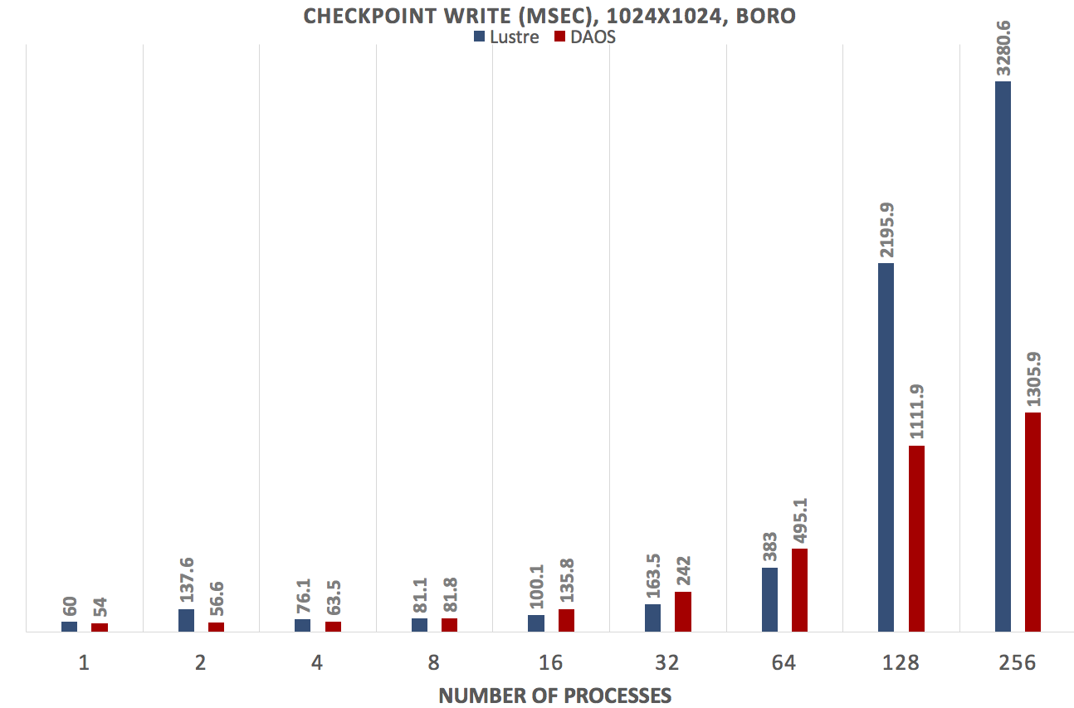
Preliminary Benchmark Results

Slide 4
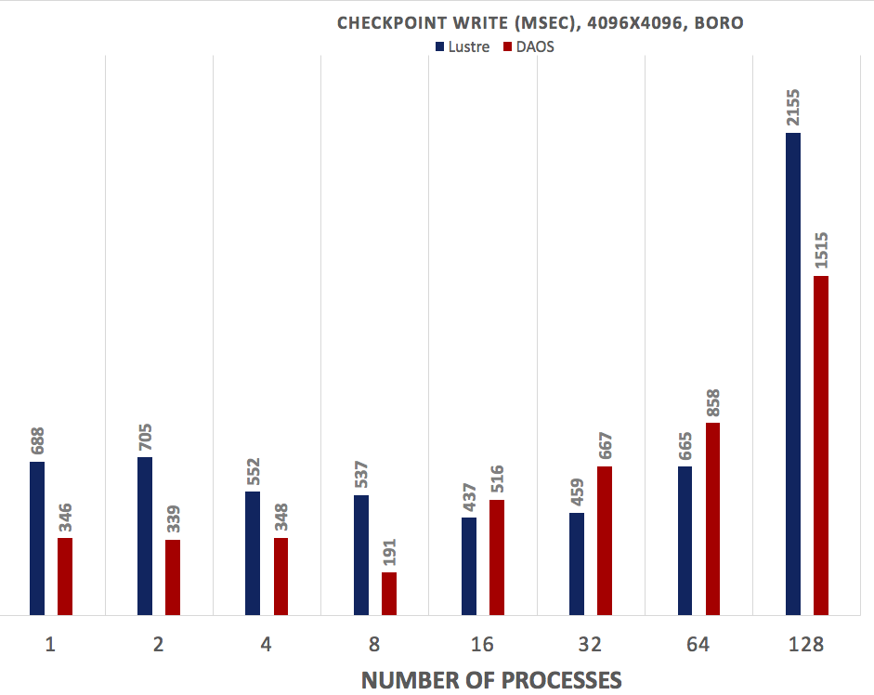
Preliminary Benchmark Results
Uses a single dkey, mapping to a single service thread at the server.

